Slide 1
UNIT-2- ANDROID UI DESIGN
MOBILE APPLICATION DEVELOPMENT
SRM IST-KTR CAMPUS

Slide 2
Android Activity Lifecycle
An activity is a single, focused thing that the user can do.
Almost all activities interact with the user, so the Activity class takes care of creating a window to place UI.
An activity represents a single screen with a user interface just like window or frame .
An activity is referred to as one screen in an application. It is very similar to a single window of any desktop application.
An Android app consists of one or more screens or activities.

Slide 3
Android Activity Lifecycle
As a user navigates through the app, Activity instances in your app transition through different stages in their life-cycle.
Activities in the system are managed as activity stacks. When a new activity is started, it is usually placed on the top of the current stack and becomes the running activity –
the previous activity always remains below it in the stack, and will not come to the foreground again until the new activity exits.
App transition by several stages ---- Activity Lifecycle

Slide 4
Android Activity Lifecycle
An activity is the single screen in android..
Java File(activity)
XML File(Layout)
Activities having four states
Activity doesn’t exist
Foreground activity
Background activity
Pause
Android Activity Lifecycle is controlled by 7 methods of android.app.Activity class. The android Activity is the superclass of MainActivity class.

Slide 5
Activity doesn’t exist
Ondestroy()
Oncreate()
Onstop()
Onstart()
Onpause()
Onresume()
Foreground Activity
Pause(onpause(), onresume())
Onresume()
Onstart()
Onpause()
Onrestart()
Onstop()
Background Activity

Slide 6
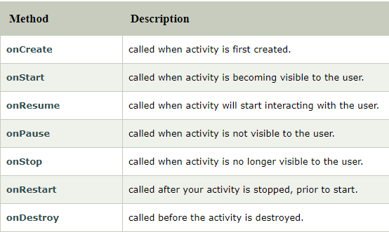
Android Activity Lifecycle methods

Slide 7
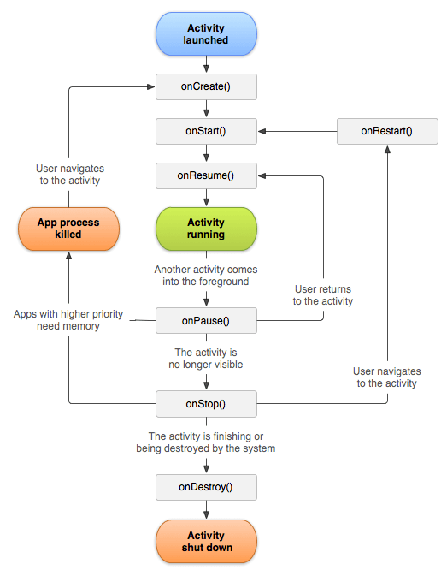
Android Activity Lifecycle methods

Slide 8
File: MainActivity.java
package example.com.activitylifecycle;
import android.app.Activity;
import android.os.Bundle;
import android.util.Log;
public class MainActivity extends Activity {
@Override
protected void onCreate(Bundle savedInstanceState) {
super.onCreate(savedInstanceState);
setContentView(R.layout.activity_main);
Log.d("lifecycle","onCreate invoked");
}

Slide 9
File: MainActivity.java
@Override
protected void onStart() {
super.onStart();
Log.d("lifecycle","onStart invoked");
}
@Override
protected void onResume() {
super.onResume();
Log.d("lifecycle","onResume invoked");
}

Slide 10
File: MainActivity.java
@Override
protected void onPause() {
super.onPause();
Log.d("lifecycle","onPause invoked");
}
@Override
protected void onStop() {
super.onStop();
Log.d("lifecycle","onStop invoked");
}

Slide 11
File: MainActivity.java
@Override
protected void onRestart() {
super.onRestart();
Log.d("lifecycle","onRestart invoked");
}
@Override
protected void onDestroy() {
super.onDestroy();
Log.d("lifecycle","onDestroy invoked");
}
}

Slide 12
Android v7 support library - API 21 for lower version support
When developing apps that support multiple API versions, you may want a standard way to provide newer features on earlier versions of Android or gracefully fall back to equivalent functionality.
Rather than building code to handle earlier versions of the platform, we can leverage support libraries to provide that compatibility layer.
Support Libraries provide additional convenience classes and features not available in the standard Framework API .

Slide 13
Android v7 support library – API 21 for lower version support
Backward Compatibility for newer APIs - A large amount of the support libraries provide backward compatibility for newer framework classes and methods.
Convenience and Helper Classes - The support libraries provides a number of helper classes, particularly for user interface development.
Debugging and Utilities - There are a number of features that provide utility beyond code you incorporate into your app.

Slide 14
Android v7 support library – API 21 for lower version support
v7 Support Libraries
These libraries provide specific feature sets and can be included in your application independently from each other.
The V7 appcompat library has migrated into the AndroidX library, which is an Android Jetpack component.
libraries in the androidx namespace ship separately from the Android platform and provide backward compatibility across Android releases
Version 28.0.0 is the last release of the Support Library.
Android Jetpack is a set of software components, libraries, tools, and guidance to help in developing robust Android applications. Launched by Google in 2018.

Slide 15
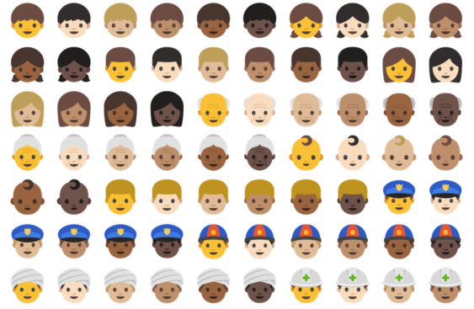
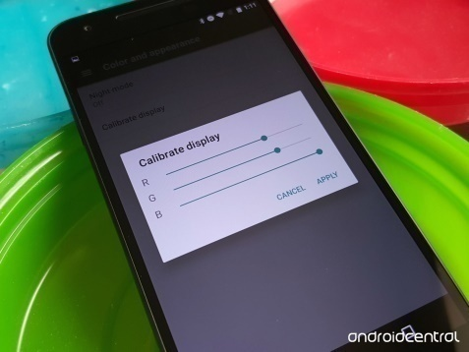
Android V7 features
skin tone modifier support.
Ability to display color calibration
Ability to screen zoom
Daydream VR platform
Improvements to file browser
Multi-window support
Keyboard image insertion
Battery usage alerts

Slide 16
Android V7 libraries
v7 appcompat library
v7 cardview library
v7 gridlayout library
v7 mediarouter library
v7 palette library
v7 recyclerview library
v7 Preference Support Library
https://developer.android.com/topic/libraries/support-library/packages

Slide 17
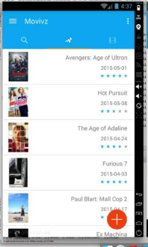
v7 appcompat library
ActionBar - Provides an action bar user interface pattern.
android.support.v7.app.ActionBar
AppCompatActivity - Adds an application activity class that can be used as a base class for activities.
android.content.Context
android.content.ContextWrapper
android.view.ContextThemeWrapper
android.app.Activity
android.support.v4.app.FragmentActivity
android.support.v7.app.AppCompatActivity

Slide 18
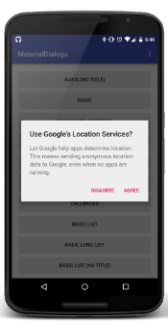
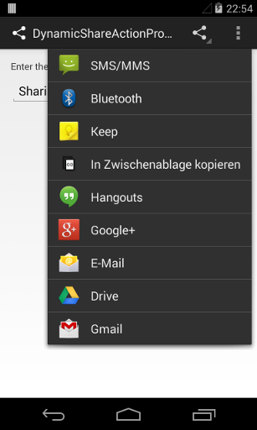
v7 appcompat library
AppCompatDialog - Adds a dialog class that can be used as a base class for AppCompat themed dialogs.
ShareActionProvider - Adds support for a standardized sharing action (such as email or posting to social applications) that can be included in an action bar.

Slide 19
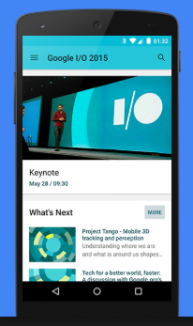
v7 cardview library
This library adds support for the CardView widget, which lets you show information inside cards that have a consistent look on any app.
These cards are useful for material design implementations, and are used in layouts for TV apps.
android.view.View
android.view.ViewGroup
android.widget.FrameLayout
android.support.v7.widget.CardView

Slide 20
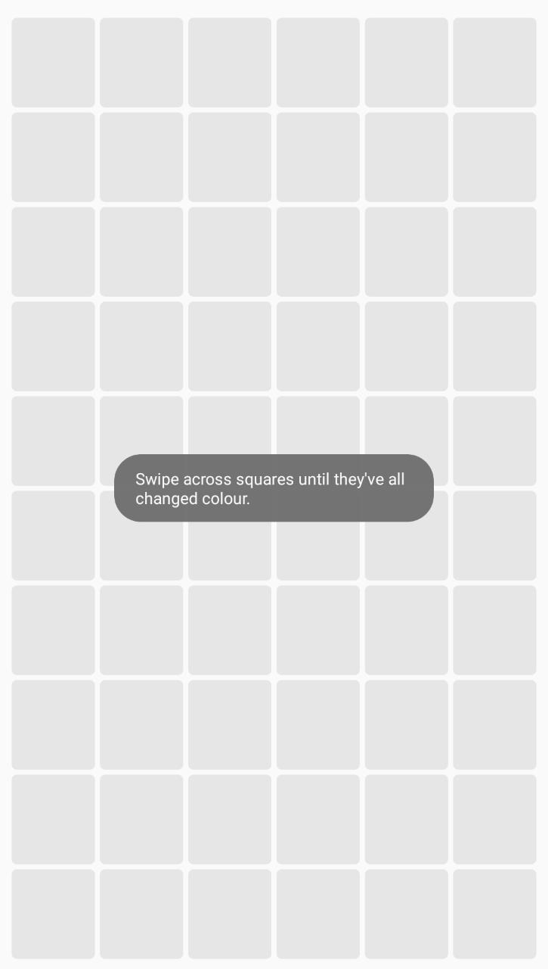
v7 gridlayout library
This library adds support for the GridLayout class, which allows you to arrange user interface elements using a grid of rectangular cells
java.lang.Object
android.view.View
android.view.ViewGroup
android.widget.GridLayout

Slide 21
v7 mediarouter library
It provides MediaRouter, MediaRouteProvider, and related media classes that support Google Cast.
The APIs in the v7 mediarouter library provide a means of controlling the routing of media channels and streams from the current device to external screens, speakers, and other destination devices.
android.support.v7.media

Slide 22
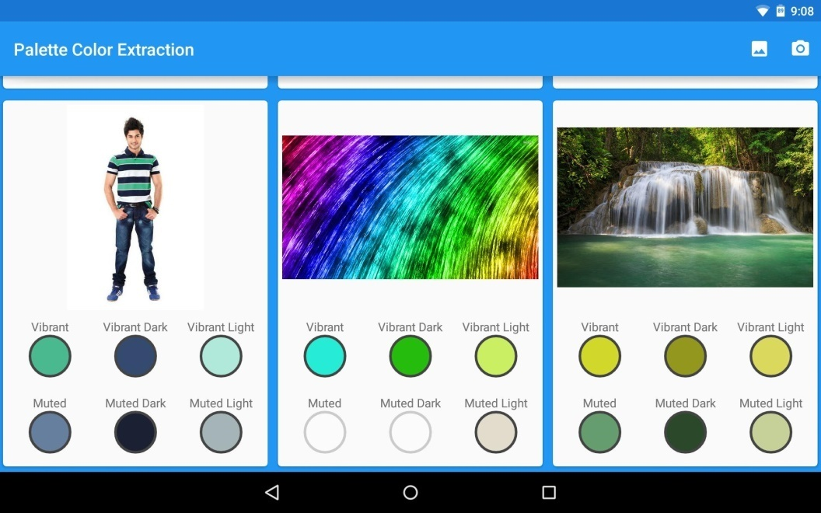
v7 palette library
The v7 palette support library includes the Palette class, which extracting color variations from an image.
For example, a music app could use a Palette object to extract the major colors from an album cover, and use those colors to build a color-coordinated song title card.

Slide 23
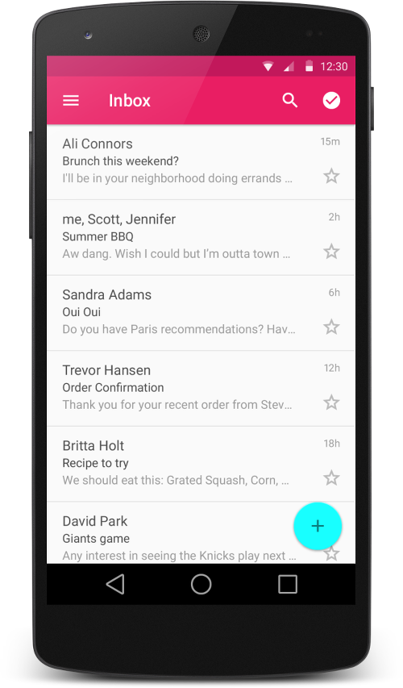
v7 recyclerview library
The recyclerview library adds the RecyclerView class.
This class provides support for the RecyclerView widget, a view for efficiently displaying large data sets by providing a limited window of data items.

Slide 24
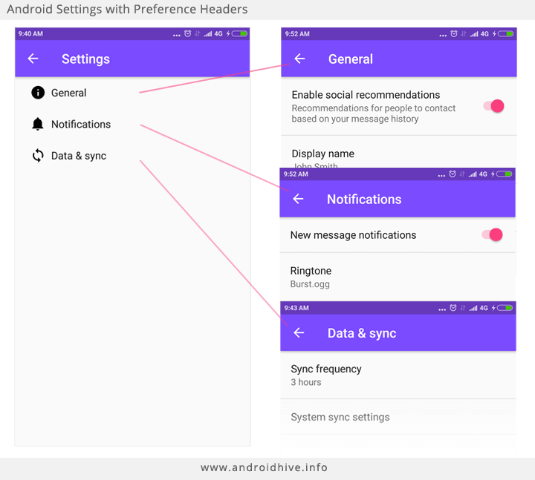
v7 Preference Support Library
The preference package provides APIs to support adding preference objects, such as CheckBoxPreference and ListPreference, for users to modify UI settings.
The v7 Preference library adds support for interfaces, such as
Preference.OnPreferenc eChangeListener
Preference.OnPreferenceClick Listener
and classes, such as
CheckBoxPreference
ListPreference

Slide 25
API Level: 21
Android 5.0 (LOLLIPOP) offers new features for users and app developers.
Support for 64-bit CPUs
Support for print previews
Material design, bringing a restyled user interface.
Project Volta, for battery life improvements.
Smart lock feature.
Updated emoji.
A flashlight-style application is included.

Slide 26
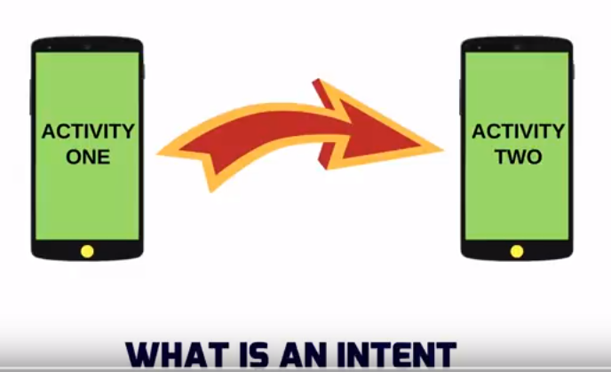
Intent
An Intent is a messaging object you can use to request an action from another app component.

Slide 27
Intent
Intents facilitate communication between components in several ways.
Intents used for
Starting an activity
An Activity represents a single screen in an app.
You can start a new instance of an Activity by passing an Intent to startActivity().
The Intent describes the activity to start and carries any necessary data.
If you want to receive a result from the activity when it finishes, call startActivityForResult().
Your activity receives the result as a separate Intent object in your activity's onActivityResult() callback.

Slide 28
Intent
Starting a service
A Service is a component that performs operations in the background without a user interface.
With Android 5.0 (API level 21) and later, you can start a service with JobScheduler.
For versions earlier than Android 5.0 (API level 21), you can start a service by using methods of the Service class.
Example
Open email, web browser and calling

Slide 29
Intent
Delivering a broadcast
A broadcast is a message that any app can receive.
The system delivers various broadcasts for system events, such as when the system boots up or the device starts charging.
You can deliver a broadcast to other apps by passing an Intent to sendBroadcast() (or) sendOrderedBroadcast().

Slide 30
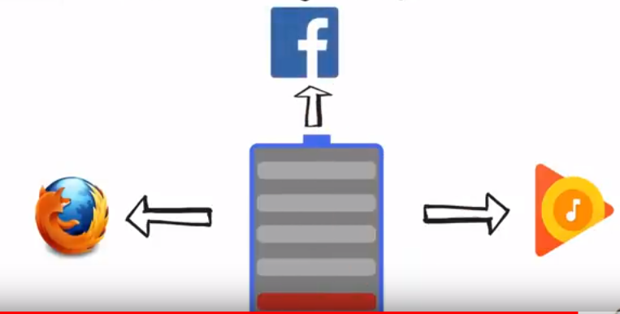
Intent

Slide 31
Intent types
Explicit Intent
Communicates between two activities inside the same application.
Example
Start a service to download a file in the background.
Implicit intents
Communicates between two activities of different applications.

Slide 32
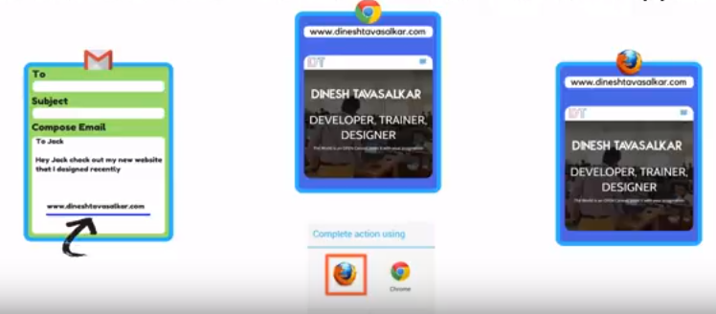
Intent types

Slide 33
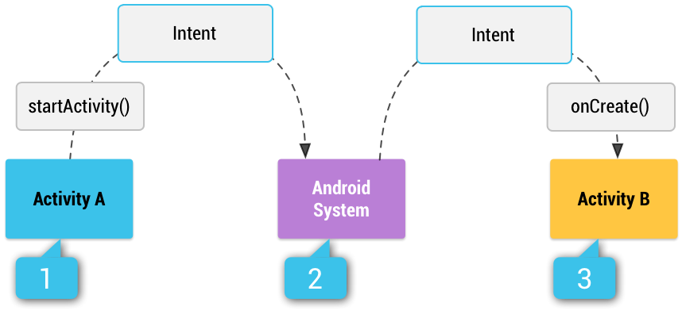
Intent

Slide 34
Intent
[1] Activity A creates an Intent with an action description and passes it to startActivity().
[2] The Android System searches all apps for an intent filter that matches the intent.
When a match is found,
[3] the system starts the matching activity (Activity B) by invoking its onCreate() method and passing it the Intent.

Slide 35
Intent Objects
An Intent object is a bundle of information which is used by the component that receives the intent as well as information used by the Android system.
An Intent object can contain the following components.
Action
This is mandatory part of the Intent object and is a string naming the action to be performed — or, in the case of broadcast intents, the action that took place and is being reported.

Slide 36
Intent Objects
The action largely determines how the rest of the intent object is structured . The Intent class defines a number of action constants corresponding to different intents.
Action - The general action to be performed, such as ACTION_VIEW, ACTION_EDIT, ACTION_MAIN, etc.
Data
Adds a data specification to an intent filter. The specification can be just a data type (the mime Type attribute), just a URI, or both a data type and a URI.

Slide 37
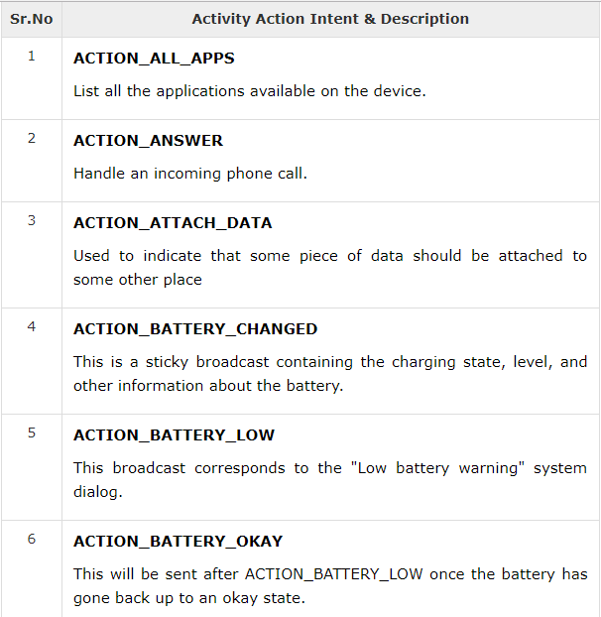

Slide 38
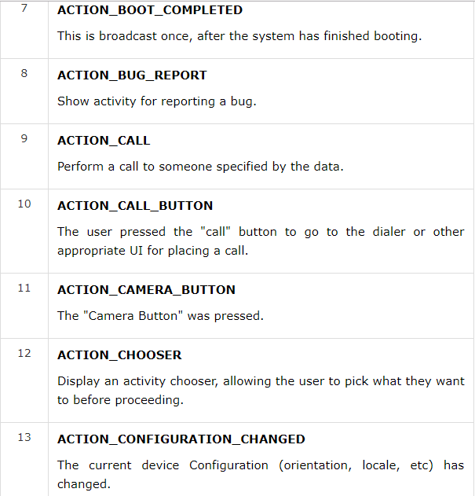

Slide 39
Intent Objects
Category
The category is an optional part of Intent object and it's a string containing additional information about the kind of component that should handle the intent.
The addCategory() method places a category in an Intent object, removeCategory() deletes a category previously added, and getCategories() gets the set of all categories currently in the object.

Slide 40
Intent Objects
A string containing additional information about the kind of component that should handle the intent.
Any number of category descriptions can be placed in an intent, but most intents do not require a category.
Here are some common categories:
CATEGORY_BROWSABLE
The target activity allows itself to be started by a web browser to display data referenced by a link, such as an image or an e-mail message.
CATEGORY_LAUNCHER
The activity is the initial activity of a task and is listed in the system's application launcher.

Slide 41
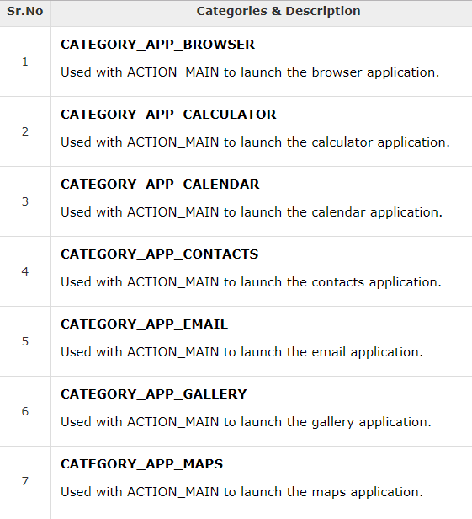

Slide 42
Intent Objects
Extras
This will be in key-value pairs for additional information that should be delivered to the component handling the intent. The extras can be set and read using the putExtras() and getExtras() methods respectively.

Slide 43
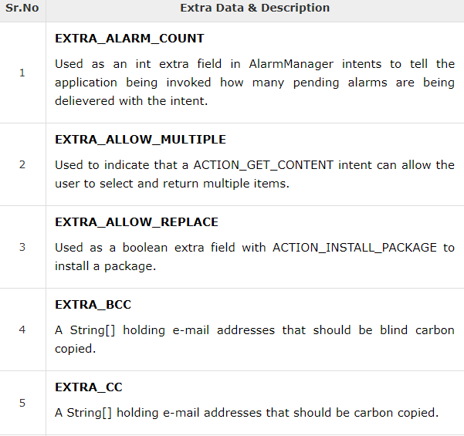

Slide 44
Intent Filter
https://developer.android.com/guide/components/intents-filters
Intent filter tell the OS how to communicate with the different components(activities, services, broadcast receives).
If we want declare intent filter we need add information into manifest file.
syntax:
<intent-filter android:icon="drawable resource"
android:label="string resource"
android:priority="integer" >
. . .
</intent-filter>

Slide 45
inter filter
You will use <intent-filter> element in the manifest file to list down actions, categories and data types associated with any activity, service, or broadcast receiver.
contained in:
<activity>
<activity-alias>
<service>
<receiver>
must contain:
<action>
can contain:
<category>
<data>

Slide 46
Intent adding category
A string containing additional information about the kind of component that should handle the intent.
Any number of category descriptions can be placed in an intent, but most intents do not require a category.
Here are some common categories:
CATEGORY_BROWSABLE
The target activity allows itself to be started by a web browser to display data referenced by a link, such as an image or an e-mail message.
CATEGORY_LAUNCHER
The activity is the initial activity of a task and is listed in the system's application launcher.

Slide 47
linking activities
An Android application can contain zero or more activities.
When your application has more than one activity, you may need to navigate from one activity to another.
In Android, you navigate between activities through what is known as an intent.

Slide 48
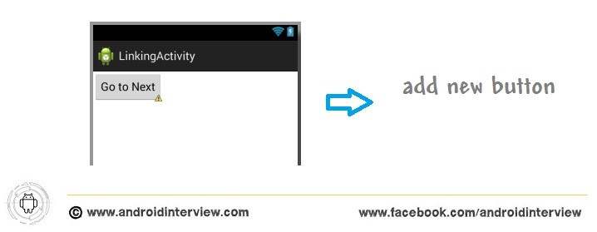
linking activities
1. Create new project with name “LinkingActivity”
2. Open res ➪ layout ➪ activity_main.xml , add button simple drag drop or follow this step’s how to add button in Android Button example , after adding new button change its button name to “Go To Next “

Slide 49
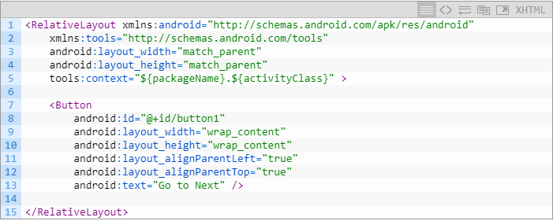
linking activities
Now see acitivty_main.xml file code

Slide 50
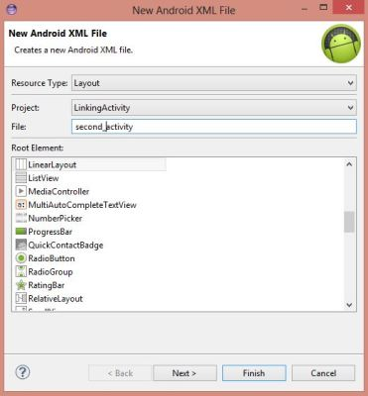
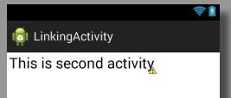
linking activities
Now you need second UI for second activity : Right Click on layout folder ➪ New ➪ Android XML file (pop up box open see figure)
4. Now click add text in
second_activity.xml
➪ “This is second Activity”

Slide 51
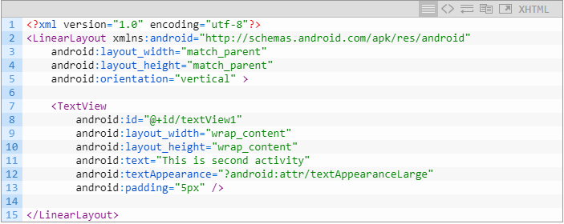
linking activities
Code of second_activity.xml

Slide 52
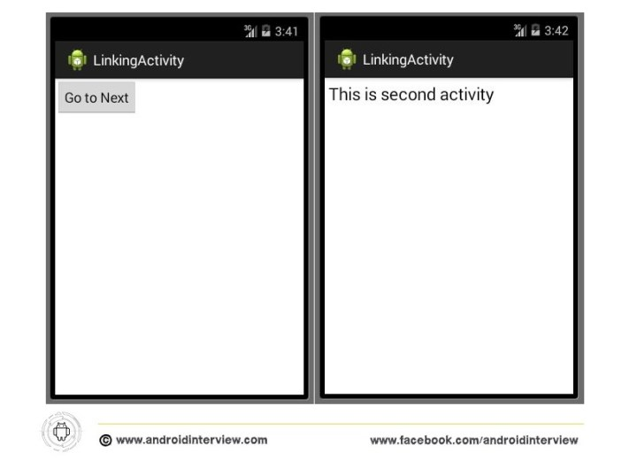
linking activities
https://youtu.be/kdaVX5NKk2M
Demo

Slide 53
user interface design components
Basic Layouts
Input Controls
Toast, Dialog and Snackbar
Navigation, ActionBar and Menus
Design Support Library
Image View
Digital Clock
Analog Clock
Text Clock
SeekBar Example (an extension of ProgressBar)
Calendar View
Drop Down List

Slide 54
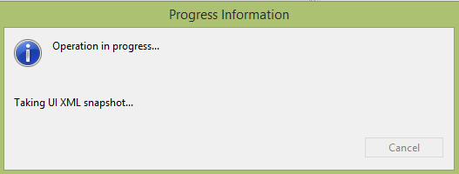
user interface design components
A typical user interface of an android application consists of action bar and the application content area.
Main Action Bar (a menu bar that runs across the top of the activity screen)
View Control
Content Area
Split Action Bar

Slide 55
Views and View Groups
View is a basic building block of UI (User Interface) in android.
View Class are the basic building block for user interface components. A small rectangular box that responds to user inputs.
A View occupies a 2-dimensional area (say: rectangle) on the screen, which is responsible for framing and handling different type of events.
Views are used to create input and output fields in the an Android App.
It can be input text field, radio field, image field etc.
They are same as, input text field, image tag to show images, radio field in HTML.

Slide 56
Views and View Groups
The View class is the base class or we can say that it is the superclass for all the GUI components in android.
View refer to the android.view.View class
Following are some of the common View subclasses that will be used in android applications.
TextView
EditText
ImageView
RadioButton
Button
ImageButton
CheckBox
DatePicker
Spinner
ProgressBar and etc.

Slide 57
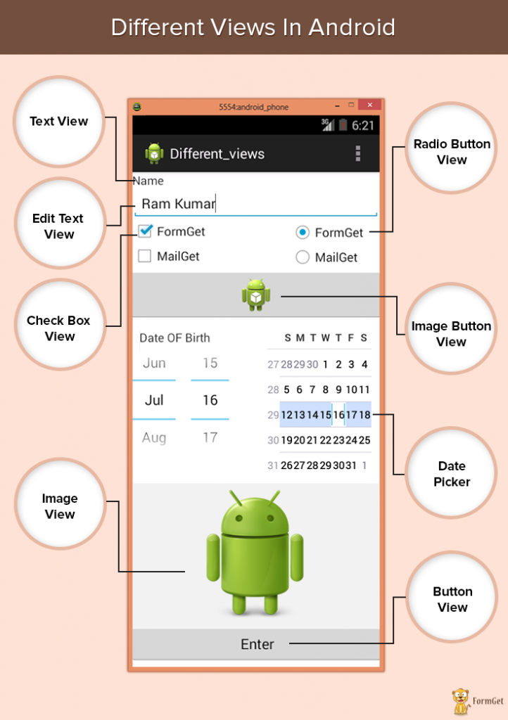

Slide 58
Views and View Groups
View Group Class
The View-Group is the base class for layouts, which holds other Views and define their properties.
ViewGroup is an invisible container of other views (child views) and other ViewGroup.
ViewGroup is a special kind of view that is extended from View as its base class.
Actually an application comprises combination and nesting of Views-Group and Views Classes.

Slide 59
Basic View
Button: Button is pushed or pressed or clicked.
Every view should have a unique identifier which identifies the element in the project. Make sure, two elements should not share their unique ID. We implement certain methods and interfaces which listens to user input and act accordingly.
TextView: This view is basically meant for displaying the text of application. For example the label of application is displayed here.

Slide 60
Basic View
EditText: This is a modification of Text View. It is editable. User can give input dynamically.
Check Box: This widget is a two-state button. It can be either checked or unchecked.
Radio Button: This is also a two-state button. It can be checked or unchecked. It can be checked dynamically.
Radio Group: This houses radio buttons together. Checking any one of the radio buttons in the group unchecks rest of the buttons.
Image Button: This a button with image. User can press or click this button. Image on the button is referenced from the src folder of our project.

Slide 61
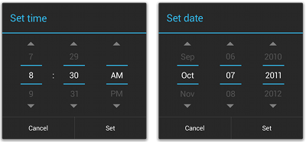
Picker View
Android provides controls for the user to pick a time or pick a date as ready-to-use dialogs.
Each picker provides controls for selecting each part of the time (hour, minute, AM/PM) or date (month, day, year).
Using these pickers helps ensure that your users can pick a time or date that is valid, formatted correctly, and adjusted to the user's locale.

Slide 62
Picker View
We recommend that you use DialogFragment to host each time or date picker.
The DialogFragment manages the dialog lifecycle for you and allows you to display the pickers in different layout configurations, such as in a basic dialog on handsets or as an embedded part of the layout on large screens.
Although DialogFragment was first added to the platform in Android 3.0 (API level 11), if your app supports versions of Android older than 3.0—even as low as Android 1.6—you can use the DialogFragment class that's available in the supportlibrary for backward compatibility.

Slide 63
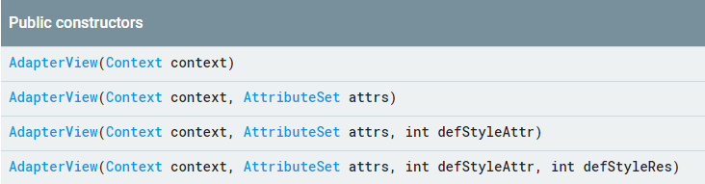
Adapter View
Adapter and Adapter View are so popular, that every time you see any app with a List of items or Grid of items, you can say for sure that it is using Adapter and Adapter View.

Slide 64
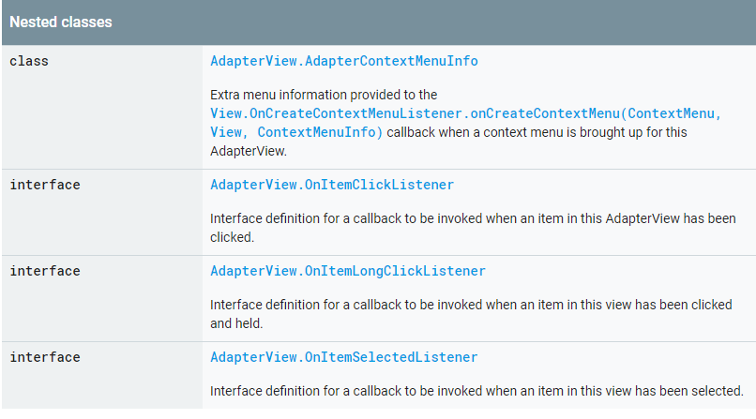
Adapter View

Slide 65
Different Layouts
Types of layout
Linear Layout
Absolute Layout
Table Layout
Frame Layout
Relative Layout

Slide 66
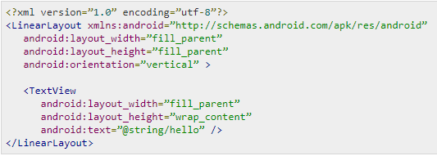
Different Layouts
Linear Layout
Linear layout is further divided into horizontal and vertical layout. It means it can arrange views in a single column or in a single row. Here is the code of linear layout(vertical) that includes a text view.

Slide 67
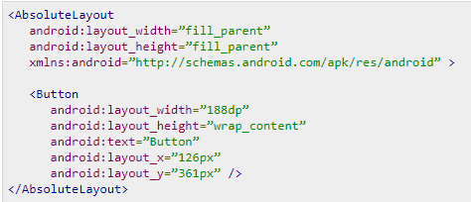
Different Layouts
AbsoluteLayout
The AbsoluteLayout enables you to specify the exact location of its children. It can be declared like this.

Slide 68
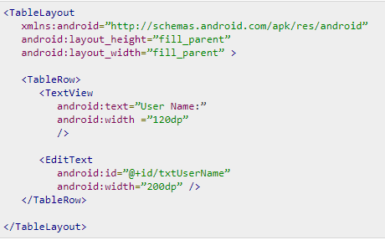
Different Layouts
TableLayout
The TableLayout groups views into rows and columns. It can be declared like this.

Slide 69
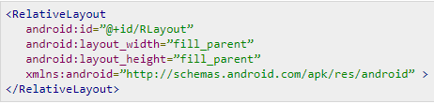
Different Layouts
RelativeLayout
The RelativeLayout enables you to specify how child views are positioned relative to each other. It can be declared like this.

Slide 70
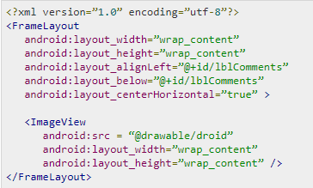
Different Layouts
FrameLayout
The FrameLayout is a placeholder on screen that you can use to display a single view. It can be declared like this.

Slide 71
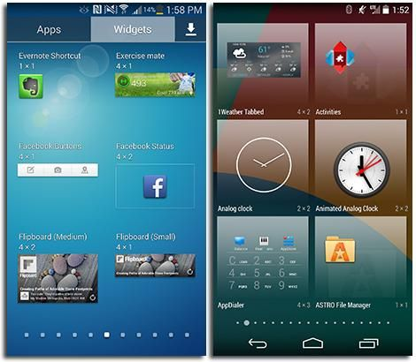
App Widgets
App widgets can be thought of as a small window or controller for an Android app that can be embedded in another application (like the homescreen).
They can be very useful, allowing users to view or control an app without actually launching it.
music widget, weather widget, clock widget etc

Slide 72
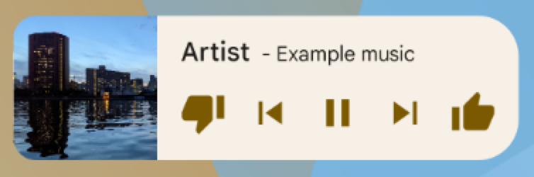
App Widgets
App widgets are miniature application views that can be embedded in other applications (such as the home screen) and receive periodic updates.
An app component that is able to hold other widgets is called an app widget host (or widget host).
To Create a simple widget

Slide 73
Lollipop Material design
Android 5.0 brings Material design to Android and gives you an expanded UI toolkit for integrating the new design patterns easily in your apps.
New 3D views let you set a z-level to raise elements off of the view hierarchy and cast realtime shadows, even as they move.
Built-in activity transitions take the user seamlessly from one state to another with beautiful, animated motion.
The material theme adds transitions for your activities, including the ability to use shared visual elements across activities.

Slide 74
Lollipop Material design
A new system-managed processing thread called RenderThread keeps animations smooth even when there are delays in the main UI thread.
ART runtime, built from the ground up to support a mix of ahead-of-time (AOT), just-in-time (JIT), and interpreted code.
It’s supported on ARM, x86, and MIPS architectures and is fully 64-bit compatible.
ART improves app performance and responsiveness. Efficient garbage collection reduces the number and duration of pauses for GC events, which fit comfortably within the v-sync window so your app doesn’t skip frames.

Slide 75
Lollipop Material design
ART also dynamically moves memory to optimize performance for foreground uses.
Notifications
Notifications in Android 5.0 are more visible, accessible, and configurable.
Varying notification details may appear on the lock screen if desired by the user. Users may elect to allow none, some, or all notification content to be shown on a secure lock screen.
Lollipop Material design video link
https://youtu.be/cAGMdQd8OZY

Slide 76
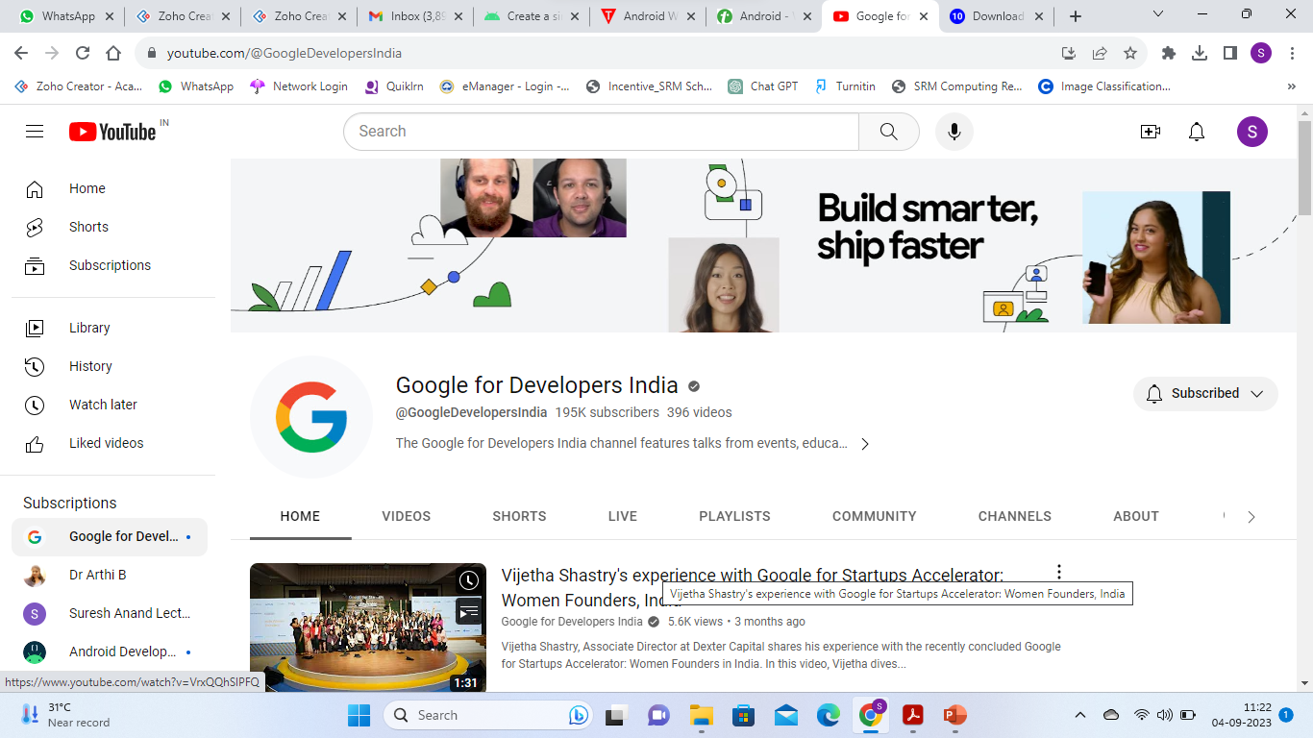
Lollipop Material design
ART also dynamically moves memory to optimize performance for foreground uses.
Notifications
Notifications in Android 5.0 are more visible, accessible, and configurable.
Varying notification details may appear on the lock screen if desired by the user. Users may elect to allow none, some, or all notification content to be shown on a secure lock screen.
Lollipop Material design video link
https://youtu.be/cAGMdQd8OZY

Slide 77
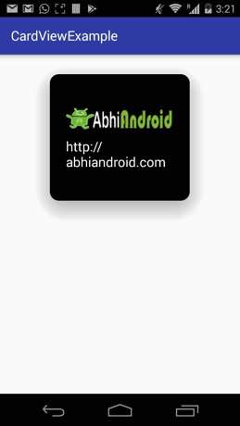
CardLayout/ CardView
CardView represents the information in a card manner with a drop shadow called elevation and corner radius which looks consistent across the platform.
CardView was introduced in Material Design in API level 21 (Android 5.0 i.e Lollipop).

Slide 78
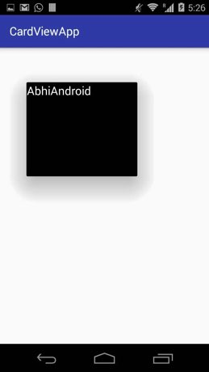
CardView
<android.support.v7.widget.CardView android:id="@+id/card_view" android:layout_width="250dp" android:layout_height="250dp" android:layout_gravity="center" card_view:cardElevation="30dp" card_view:cardBackgroundColor="#000">
<!-- card elevation value 30dp and black background --> <TextView android:layout_width="match_parent" android:layout_height="match_parent" android:text="AbhiAndroid"
android:textColor="#fff"
android:textSize="20sp" /> </android.support.v7.widget.CardView>

Slide 79
CardLayout/ CardView
CardView Example Using
RecyclerView as GridView

Slide 80
RecyclerView
The RecyclerView class extends the ViewGroup class and implements ScrollingView interface.
RecyclerView is a ViewGroup added to the android studio as a successor of the GridView and ListView.
It is introduced in Marshmallow.

Slide 81
RecyclerView
The RecyclerView class supports the display of a collection of data.
It is a modernized version of the ListView and the GridView classes provided by the Android framework.
Recycler view addresses several issues that the existing widgets have.
It enforced a programming style that results in good performance.
It also comes with default animations for removing and adding elements.

Slide 82
RecyclerView
RecyclerView allow to use different layout managers for positioning items.
Recycler view uses a ViewHolder to store references to the views for one entry in the recycler view.
A ViewHolder class is a static inner class in your adapter which holds references to the relevant views.
With these references your code can avoid the time-consuming findViewById() method to update the widgets with new data.
https://youtu.be/QW0o21ZjmDM

Slide 83
Fragments
Android Fragment is the part of activity, it is also known as sub-activity.
A Fragment is a piece of an activity which enable more modular activity design.
There can be more than one fragment in an activity.
Fragments represent multiple screen inside one activity.

Slide 84
Fragments
A Fragment represents a behavior or a portion of user interface in a FragmentActivity.
You can combine multiple fragments in a single activity to build a multi-pane UI and reuse a fragment in multiple activities.
A fragment must always be hosted in an activity.
The fragment's lifecycle is directly affected by the host activity's lifecycle.

Slide 85
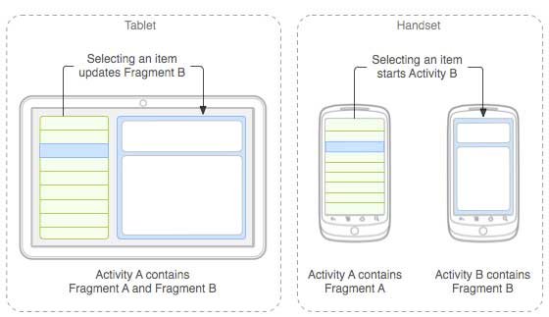
Fragments
The application can embed two fragments in Activity A, when running on a tablet-sized device.
On a handset-sized screen, there's not enough room for both fragments, so Activity A i`ncludes only the fragment for the list of articles, and when the user selects an article, it starts Activity B, which includes the second fragment to read the article.

Slide 86
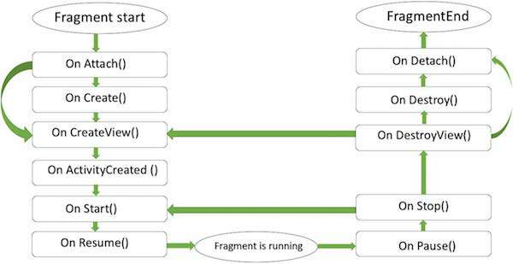
Fragment Life Cycle
Android fragments have their own life cycle very similar to an android activity. This section briefs different stages of its life cycle.

Slide 87
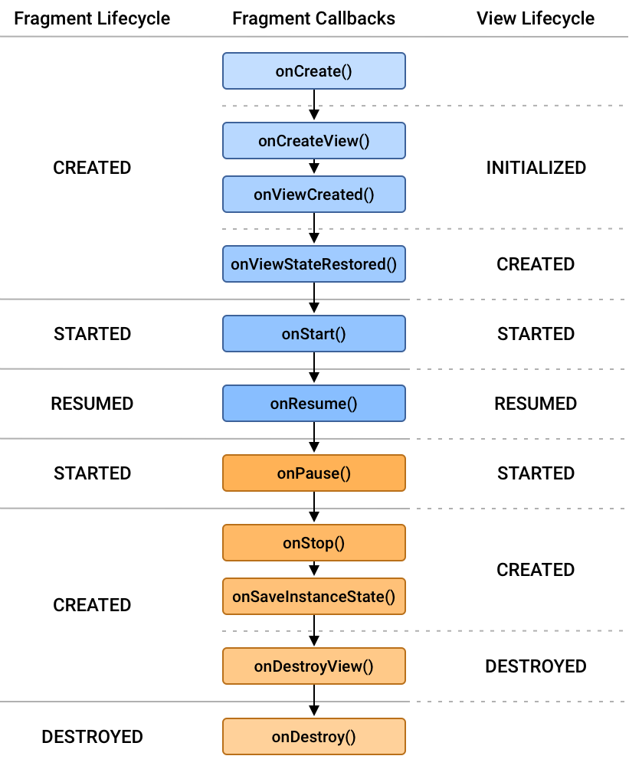
Fragment Life Cycle

Slide 88
Fragment Life Cycle
OnAttach() The fragment instance is associated with an activity instance.
The fragment and the activity is not fully initialized. Typically you get in this method a reference to the activity which uses the fragment for further initialization work.
it is called only once when it is attached with activity.
onCreate() The system calls this method when creating the fragment.
You should initialize essential components of the fragment that you want to retain when the fragment is paused or stopped, then resumed.

Slide 89
Fragment Life Cycle
onCreateView() The system calls this callback when it's time for the fragment to draw its user interface for the first time.
To draw a UI for your fragment, you must return a View component from this method that is the root of your fragment's layout.
You can return null if the fragment does not provide a UI.
onActivityCreated() The onActivityCreated() is called after the onCreateView() method when the host activity is created.
Activity and fragment instance have been created as well as the view hierarchy of the activity.

Slide 90
Fragment Life Cycle
At this point, view can be accessed with the findViewById() method.
onStart() The onStart() method is called once the fragment gets visible.
onResume() Fragment becomes active. makes the fragment interactive.
onPause() is called when fragment is no longer interactive.
This is usually where you should commit any changes that should be persisted beyond the current user session.
onStop() is called when fragment is no longer visible.

Slide 91
Fragment Life Cycle
onDestroyView() allows the fragment to clean up resources.
onDestroy() onDestroy() called to do final clean up of the fragment's state but Not guaranteed to be called by the Android platform.
OnDetach() It is called immediately prior to the fragment no longer being associated with its activity.
https://youtu.be/pI5kh94soac

